Slide 1

Title: Unraveling IBM Employee Attrition
Presented by : Group 6
Anantha Dasari, Harishwar Reddy Pasupu, Rohit Surapalli, Thrishanka Gade , Uma Mahesh Thadadhi

Slide 2
Summary of contributions
Team Member | Contribution
Anantha Lakshmi Dasari(11643644) | Implemented the model using software Built and trained models to predict which factors increase the likelihood of attrition. Evaluated model performance to ensure reliable predictions. Compiled the final report
Harishwar Reddy Pasupu(11773776) | Collected data Cleaned the data and performed necessary transformation Implemented the model using software. Helped interpret the data in the context of employee satisfaction and attrition
Rohit Surapalli(11724161) | - Cleaned the data and performed necessary transformation Interpreted the outputs and provided insights Helped interpret the data in the context of employee satisfaction and attrition
Thrishanka Gade(11762836) | Implemented the model using software Built and trained models to predict which factors increase the likelihood of attrition Evaluated model performance to ensure reliable predictions Compiled the final report.
UmaMahesh Thadadhi(11752819) | Cleaned the data and performed necessary transformation Provided actionable recommendations Helped interpret the data in the context of employee satisfaction and attrition

Slide 3

Executive Summary
Objective: The goal of this project was to build predictive models to forecast IBM employee attrition and performance.
Models: Logistic regression analysis, decision trees, and Neural Network models are used to predict the attrition rate and derive actionable insights at IBM Organization.
Logistic regression: We performed stepwise logistic regression, and the model was found to be significant. From the output, Business Travel, Over Time, Job Involvement, Work-Life Balance, Job Satisfaction, and Job Role as important predictors.
Training Accuracy: 90.46% ,Validation Accuracy: 88.18%
Decision Tree: We obtained the best results from the decision tree with a maximum of 3 branches. Monthly Income, Over Time, Total Working Years, Job Role, and Stock Options are important variables. Root node split was based on Over Time,
Misclassification rate of 0.125(validation dataset)
Neural Network: We achieved the best results from the neural network model with default hidden layers. The model's performance on the validation dataset showed a misclassification rate of 0.10135 and indicating strong predictive capability for employee attrition.
Training Accuracy: 90.38% , Validation Accuracy: 89.87%
Business Implications: Based on the results, we recommend addressing overtime Concerns, Optimizing Compensation, Workforce Planning and Enhancing Stock Option Plans majorly and few other concerns can reduce the IBM attrition rate.

Slide 4

Project Motivation/Background
Why was this project chosen:
Employee turnover is a major challenge for many organizations.
By analyzing data, this project aims to find key factors influencing employee attrition and performance to help businesses keep valuable employees and improve overall workforce management.
Why is this Important:
High attrition rates can lead to increased recruitment costs, loss of organizational knowledge, and reduced employee morale.
When employees leave, it costs companies money and affects productivity.
Understanding the factors that drive performance, and retention can help companies reduce turnover, increase employee satisfaction, and keep their workforce strong
Impact of the Project
The findings will help IBM HR teams identify employees who might leave, improve retention efforts, and provide practical steps to boost employee satisfaction and in turn reduce attrition rate.

Slide 5
Data Description
Summary Statistics
What data was involved?
Dataset is created by IBM data scientists to simulate real-world HR data for analysing employee attrition.
Total number of observations is 1470 with 35 independent attributes with “Attrition” as Target variable with Yes/No value.
In the dataset, for the variable Attrition (target variable), the frequency distribution is as follows:
No (indicating employees who did not leave the company) appears 1233 times, accounting for 83.88% of the total records.
Yes (indicating employees who left the company) appears 237 times, making up 16.12% of the total records.
Variable | Mean | Std.Dev | Min | Max
Age | 36.92381 | 9.135373 | 18 | 0.413286
Monthly Income | 6502.931 | 4707.957 | 1009 | 19999
Variable | Mode % | Levels | Mode2 %
Work life Balance | 60.75 | 4 | 23.40
Stock option Level | 42.93 | 4 | 40.54
Job role | 22.18 | 9 | 19.86
Job satisfaction | 31.22 | 4 | 30.07
Overtime | 71.70 | 2 | 28.30
Performance rating | 84.63 | 2 | 15.37
Job Involvement | 59.05 | 4 | 25.51

Slide 6

Data Preparation Activities
After importing the data, we analyzed the variables to gain a better understanding.
During this process, we decided to exclude the employee count variable, as it did not have any significance to our analysis.
Handling Missing Values:
The dataset is complete and contains no missing values, ensuring data integrity and enabling accurate analysis.
Outlier Treatment:
Using Box plot we Identified variables Years at company, Years in current role, Years since last promotion, Monthly income, Total working years, Years with current manager, Training times last year has identifiers.
Feature Transformation:
We applied log transformation to ensure logistic and Neural network models could interpret the data correctly.
No transformation applied to Decision tree as it is robust it can handle as splits are created based on data ranges rather than specific values, meaning outliers do not significantly influence model structure.

Slide 7
Model selection for IBM Attrition Data set
Model | Consideration | Justification
Linear Regression | NO | Since our target variable is non-numeric, we cannot apply this method.
Logistic Regression | YES | Since our target variable is categorical, logistic regression best suites for our data
Neural Network | YES | Since our target variable is non-numeric, we can apply a neural network, which is well-equipped to handle categorical data
Decision Tree | YES | Since our target variable is non-numeric, we can apply a decision tree, as it is well-suited for handling categorical targets and would perform better in this case
Principal component Analysis | NO | Principal Component Analysis (PCA) cannot be applied to our data because our target variable is non-numeric, and we have a large number of nominal predictors
Cluster Analysis | YES | Cluster analysis was used as a descriptive technique to better understand the data by grouping similar observations together
Recommended systems | NO | It is for transactional data and our data set is not transactional kind of data, so not applicable

Slide 8
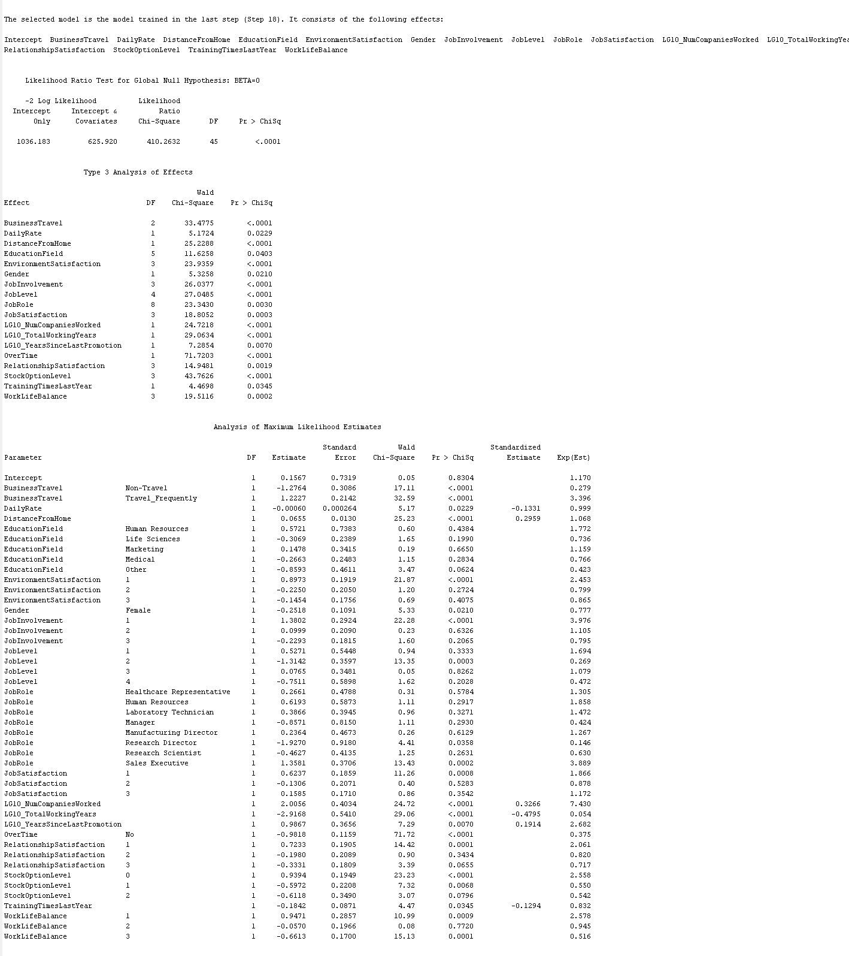
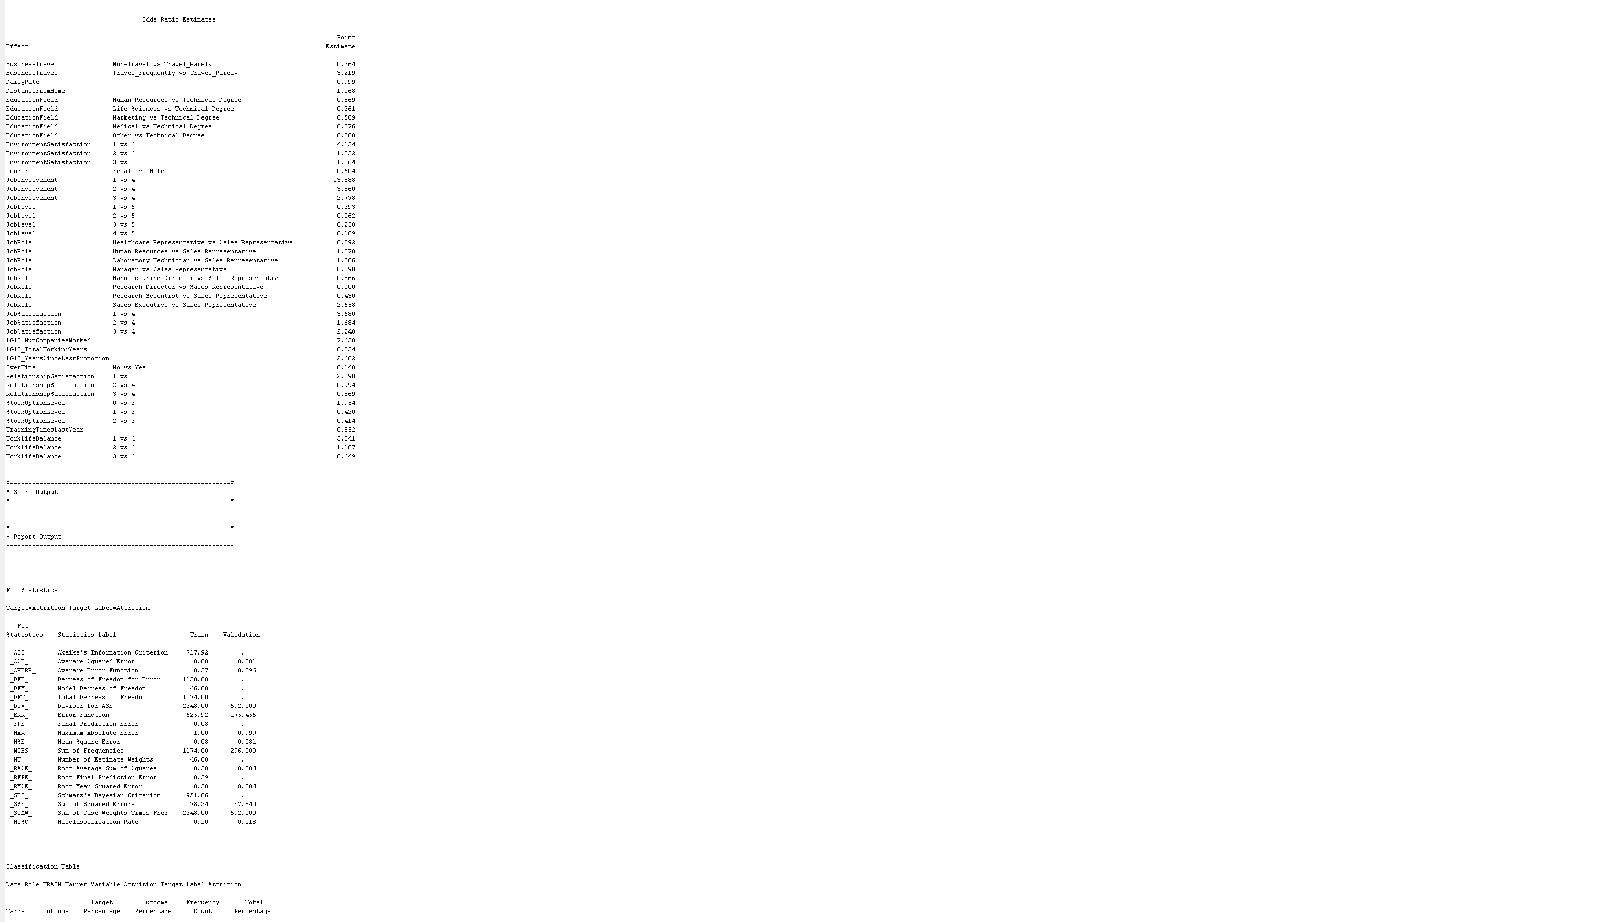
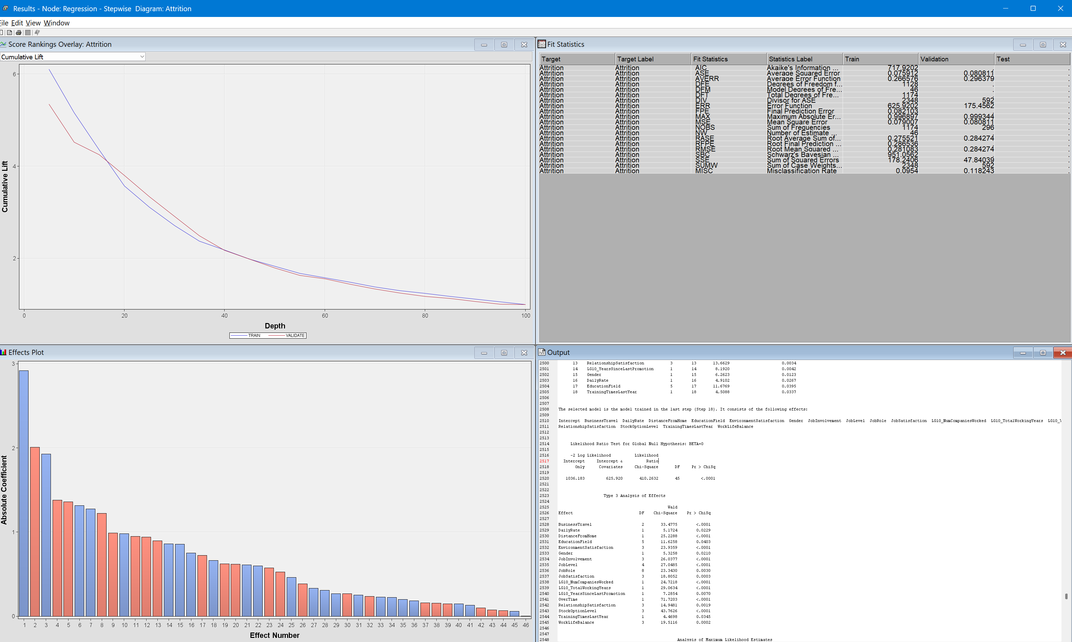
Model 1: Logistic Regression
Logistic regression was used for predicting employee attrition (binary outcome: Yes or No).
We applied three variations of logistic regression: the stepwise logistic regression, and forward and backward logistic regression.
After comparing the results, all three models yielded identical misclassification rates and performed similarly overall
As a result, we selected the stepwise logistic regression model due to its simplicity and efficiency, while achieving the same predictive performance as the other models.
The model was found to be statistically significant with Chi-Square statistic of p < 0.0001.

Slide 9
Findings
What did model tell you?
The logistic regression model has identified several significant variables that influence employee attrition. The significant variables are mentioned below:
Business Travel ,Daily Rate, Distance from Home, Educational Field, Environment Satisfaction, Gender, Job Involvement, Job level, Job Satisfaction, Number of Companies Worked , Total Working Years , Years Since Last Promotion , Over Time, Relationship Satisfaction, Stock Option Level, Training Times Last Year, Work Life Balance
Does it suggest a particular group of variables are most important?
Based on output of model we found Business Travel, Over Time, Job Involvement and work-life balance and job satisfaction and job role are important because of their odds ratio and coefficient value from the results obtained.
How do they influence your dependent variable(s) of interest
Overtime: Employees who work overtime are significantly more likely to leave.
Job involvement: Employees who are less involved in their jobs are more likely to leave.
Work-life balance: Employees with poor work-life balance are more likely to leave.
Job satisfaction: Employees who are less satisfied with their jobs are more likely to leave.
Stock option level: Employees with lower stock option levels are more likely to leave.

Slide 10
Is one more important than the others?
In logistic regression, it is not always straightforward to state that one variable is more important than another. However, we can interpret how strongly a variable is associated with the outcome based on odds ratio
For example, odds ratio for "Overtime - No" is 0.375, it means that employees who doesn't work overtime are more likely to stay (lower attrition) compared to those who do , holding other factors constant.
On the other hand, odds ratio for "Stock option" is more than 1, it implies that as stock option level increases, the likelihood of attrition decreases.

Slide 11
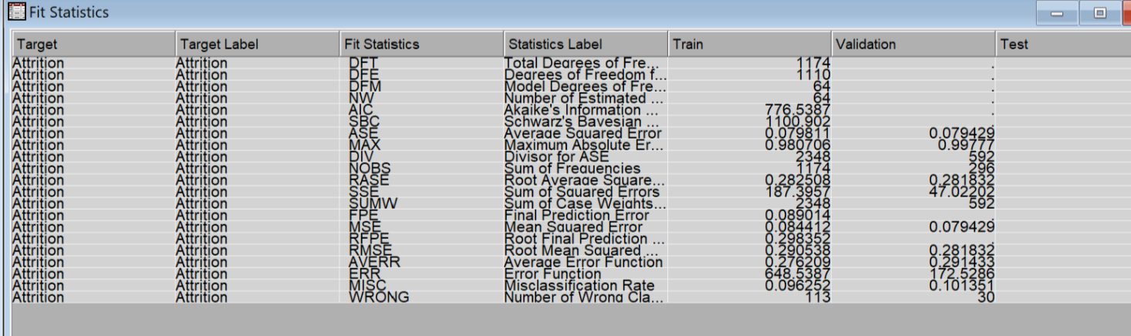
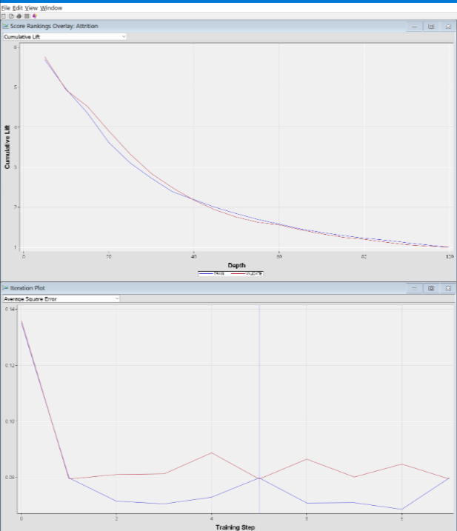
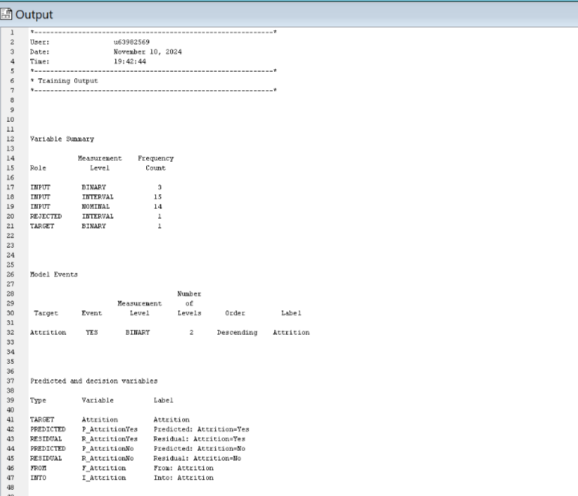
Model 2: Neural Network
The Auto Neural technique was employed to automatically configure and train a neural network, allowing us to explore multiple network architectures and identify an optimal structure for our dataset.
We tested various configurations, focusing specifically on models with 2 and 3 hidden units to strike a balance between accuracy and computational efficiency.
Both configurations demonstrated the same misclassification rate, indicating that increasing the number of hidden units did not improve accuracy.
Given this outcome, we selected the model with 2 hidden units, as it is computationally lighter and faster to train while maintaining the same predictive performance as the more complex model.
This approach not only reduces processing time and resource consumption but also simplifies the model, making it easier to interpret and deploy.

Slide 12
Findings
What did the model tell you?
Model performed well with high accuracy on validation data 87.84% and low Misclassification error is 0.1216
The best results are obtained from this model.
Which variables are important? Is one more important than the others?
We cannot directly identify the important variables in a neural network, but the model itself can highlight them through techniques like feature importance or by examining the weights assigned to each variable during training.
How do they influence your dependent variable(s) of interest?
In neural networks, predictors influence the target variable through the learned weights and activations across multiple layers.
Each input feature is weighted, transformed by activation functions, and combined in hidden layers to capture complex relationships.
The network adjusts these weights to minimize the prediction error during training. Understanding how predictors influence the target can be challenging due to the model's complexity

Slide 13
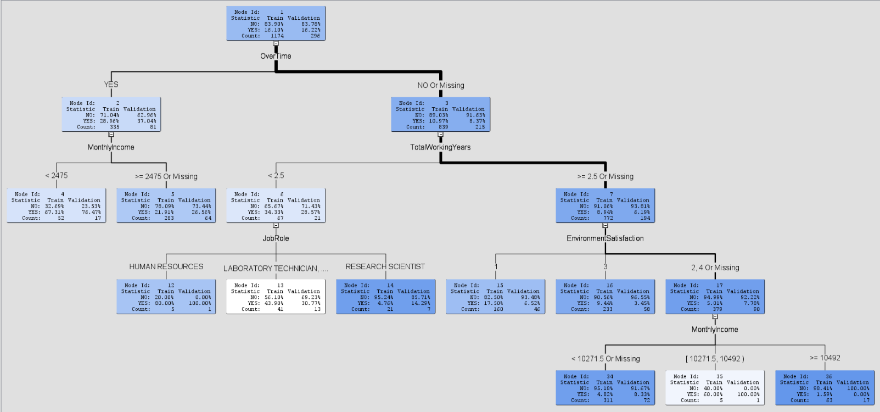
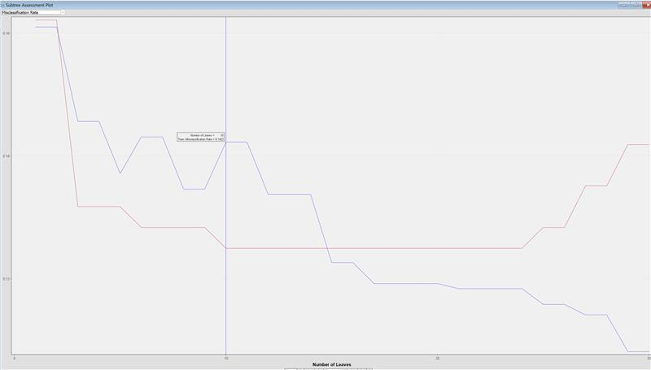
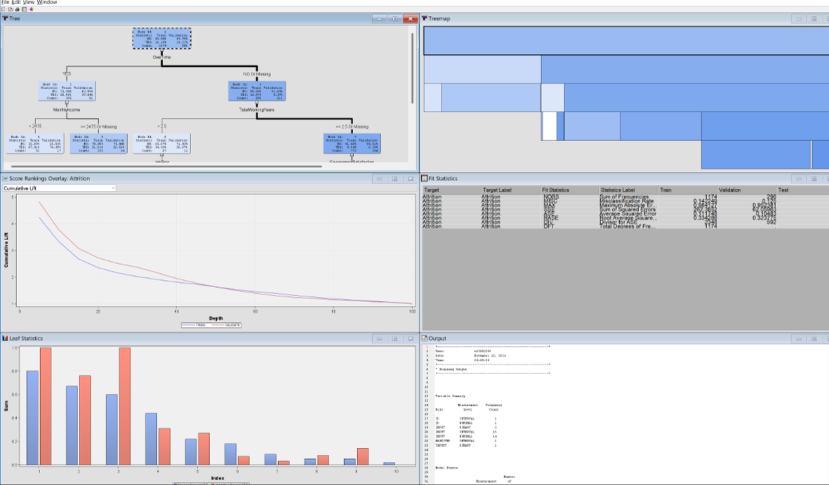
Model 3: Decision Tree
By applying Decision tree technique to our dataset, it works by splitting the data into groups based on overtime, Total working Years predictors, creating a tree-like structure.
We applied three Decision Tree models: one optimized, one using Average Squared Error, and one with a maximum of 3 branches. We are opting for the model with the 3-branch limit as it has the lowest misclassification error.
The Decision Tree model performed well in predicting attrition, with 87.5 accuracy and misclassification rate 0.125.

Slide 14
Findings
What did the model tell you?
The model appears to perform reasonably well in predicting employee attrition with below misclassification rates 0.14 for training and 0.125 for validation, indicating reasonable predictive power.
Generated decision tree has 10 Nodes
Which variables are important?
Monthly Income, Over Time, Total Working Years, Job Role, Stock option
How do they influence your dependent variable(s) of interest?
Here’s how the key predictors influence the dependent variable, Attrition:
Monthly Income:
Impact: Employees with lower incomes are more likely to leave the organization. Higher salaries are a significant factor in reducing attrition.
Influence: The higher the income, the lower the probability of attrition.
2. Over Time:
Impact: Employees who frequently work overtime are more prone to burnout and dissatisfaction, leading to higher attrition rates.
Influence: Increased overtime strongly correlates with a higher likelihood of leaving.

Slide 15
Findings
3. Total Working Years:
Impact: Employees with fewer total working years are at a greater risk of leaving, possibly due to limited experience and perceived career advancement opportunities.
Influence: More working years reduce the likelihood of attrition.
4. Job Role:
Impact: Certain roles experience higher attrition based on the nature of the work and available career development paths. This suggests targeted engagement is needed for roles with higher attrition risk.
Influence: Attrition likelihood varies significantly by job role.
5. Stock option:
Impact: Employees without stock options are more likely to leave, suggesting that offering stock options could enhance employee retention by increasing their sense of ownership in the company.
Influence: Providing stock options is associated with a reduced likelihood of attrition, as it contributes to employee satisfaction and commitment.
These variables collectively provide insights into factors that influence whether employees stay or leave, guiding retention strategies.

Slide 16
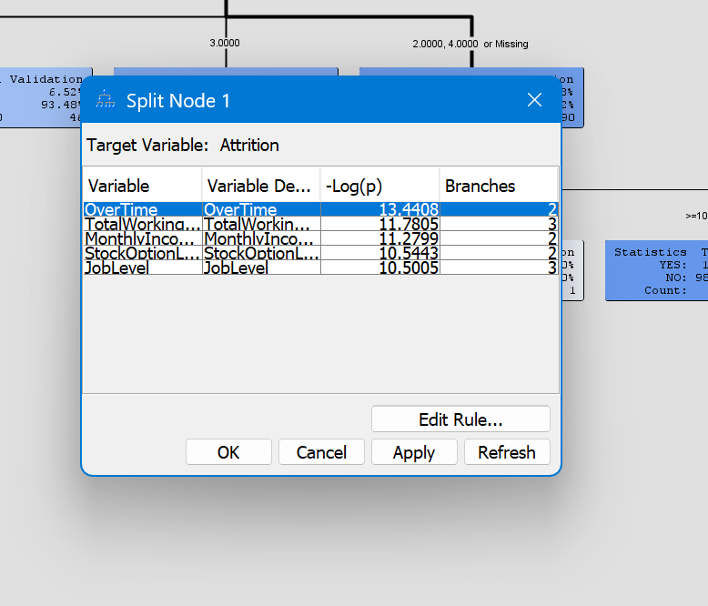
Is one more important than the others?
OverTime is the most important predictor of employee attrition, as the decision tree splits at the root node based on overtime indicating that the employee who work more hours is likely to leave the organization.
From the model output predictor, Total Working Years, comes as second most important followed by monthly income and Stock option levels

Slide 17
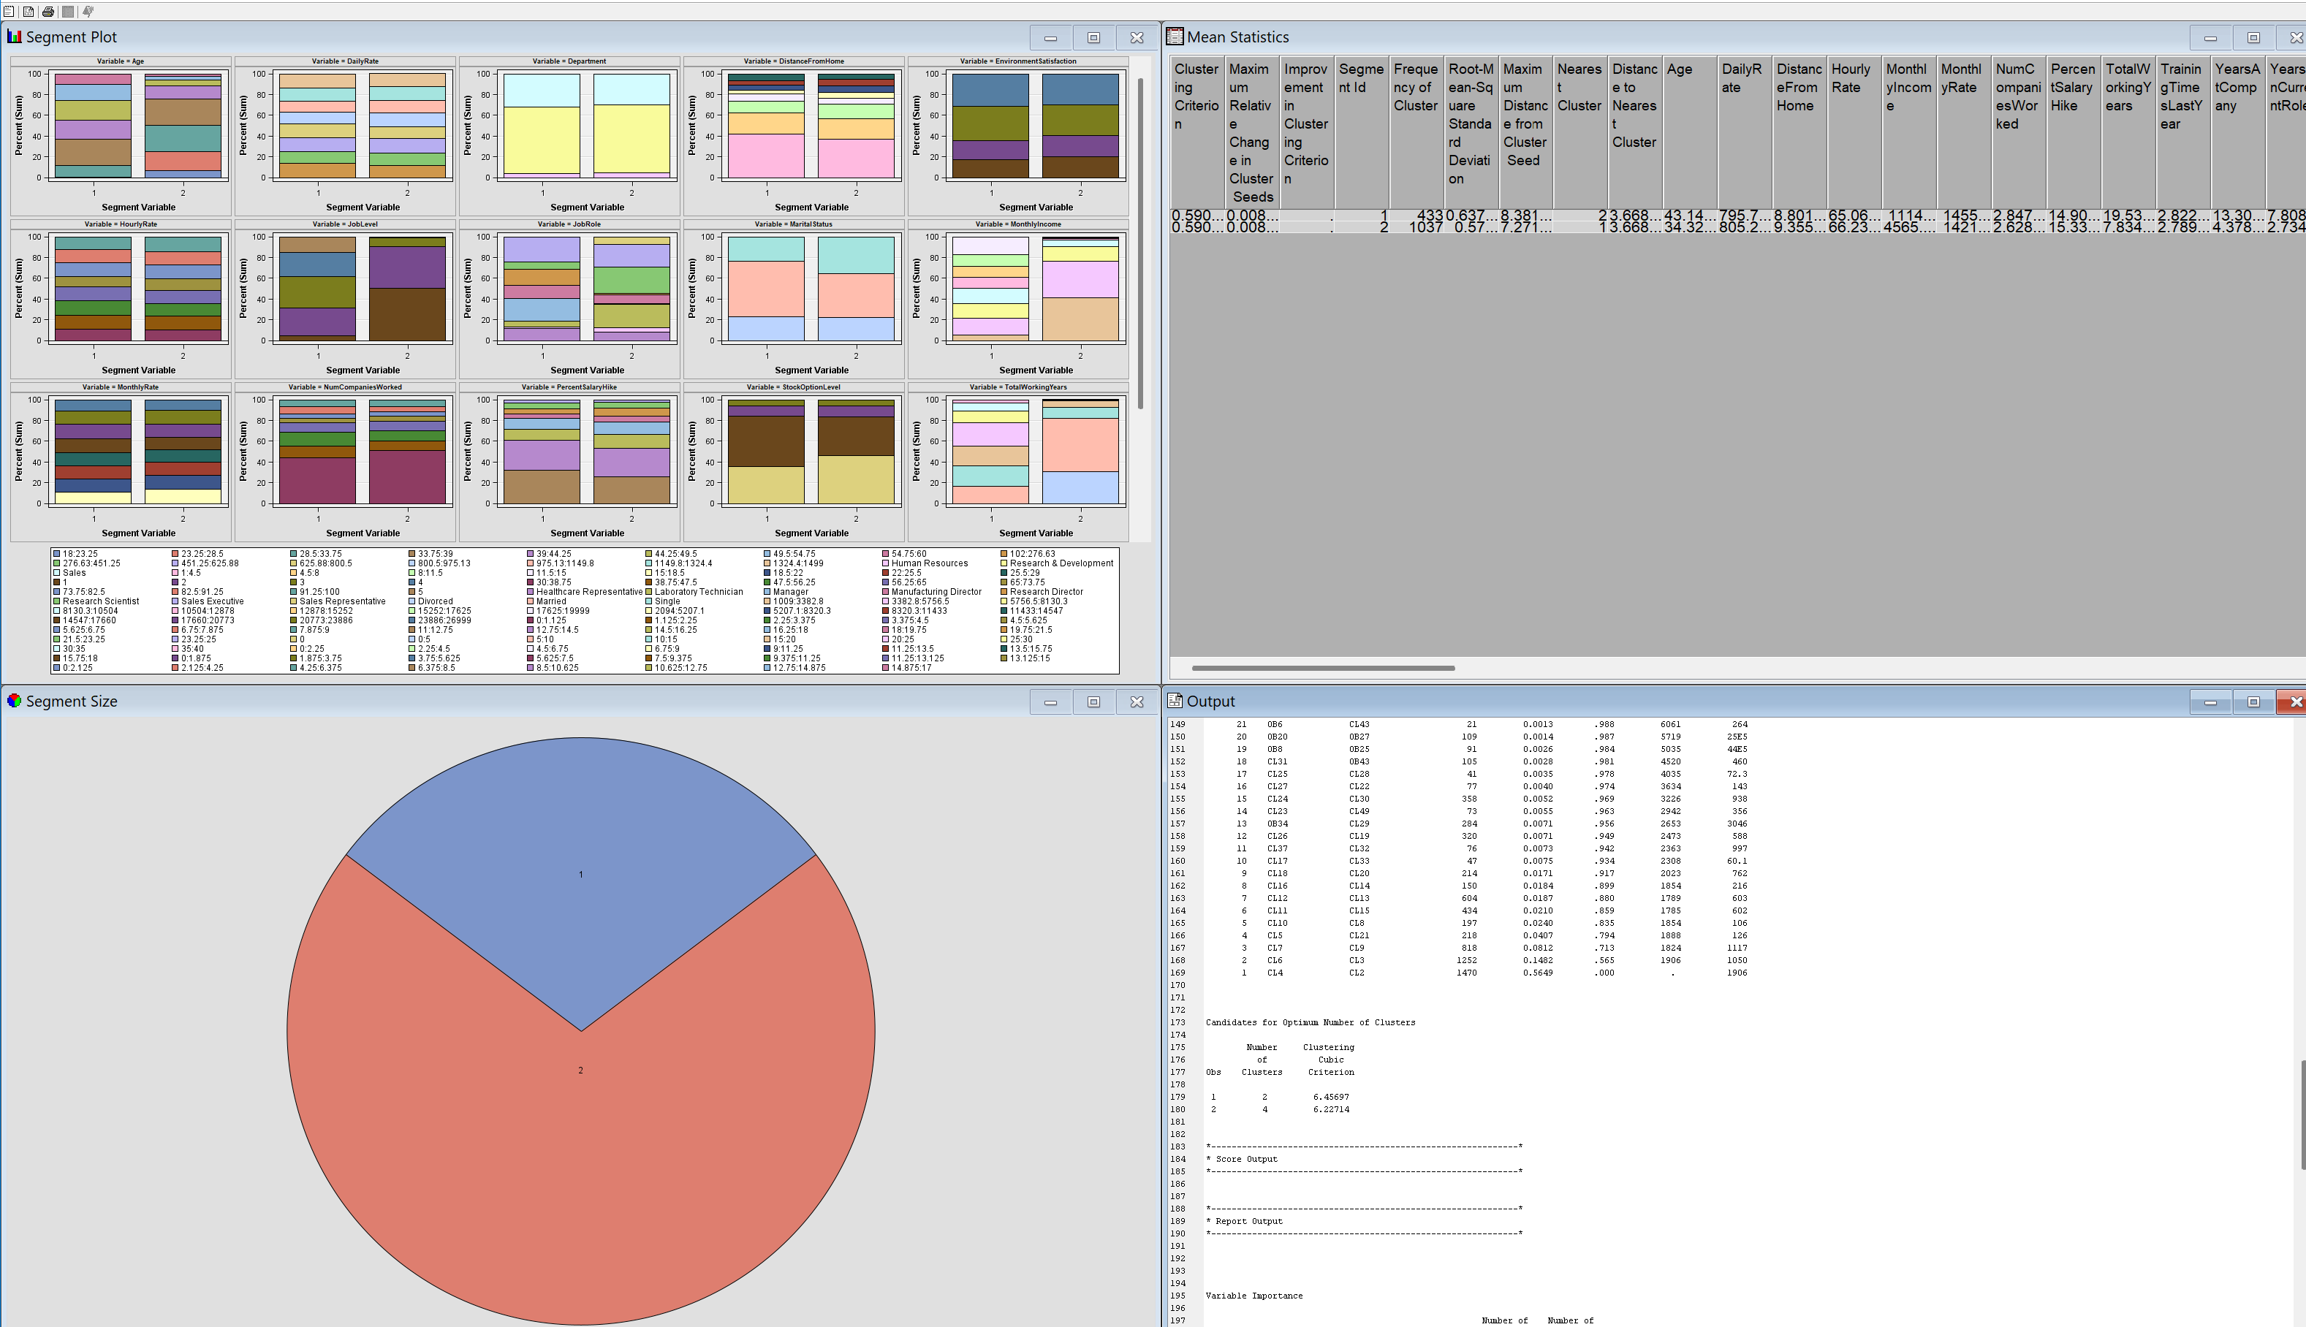
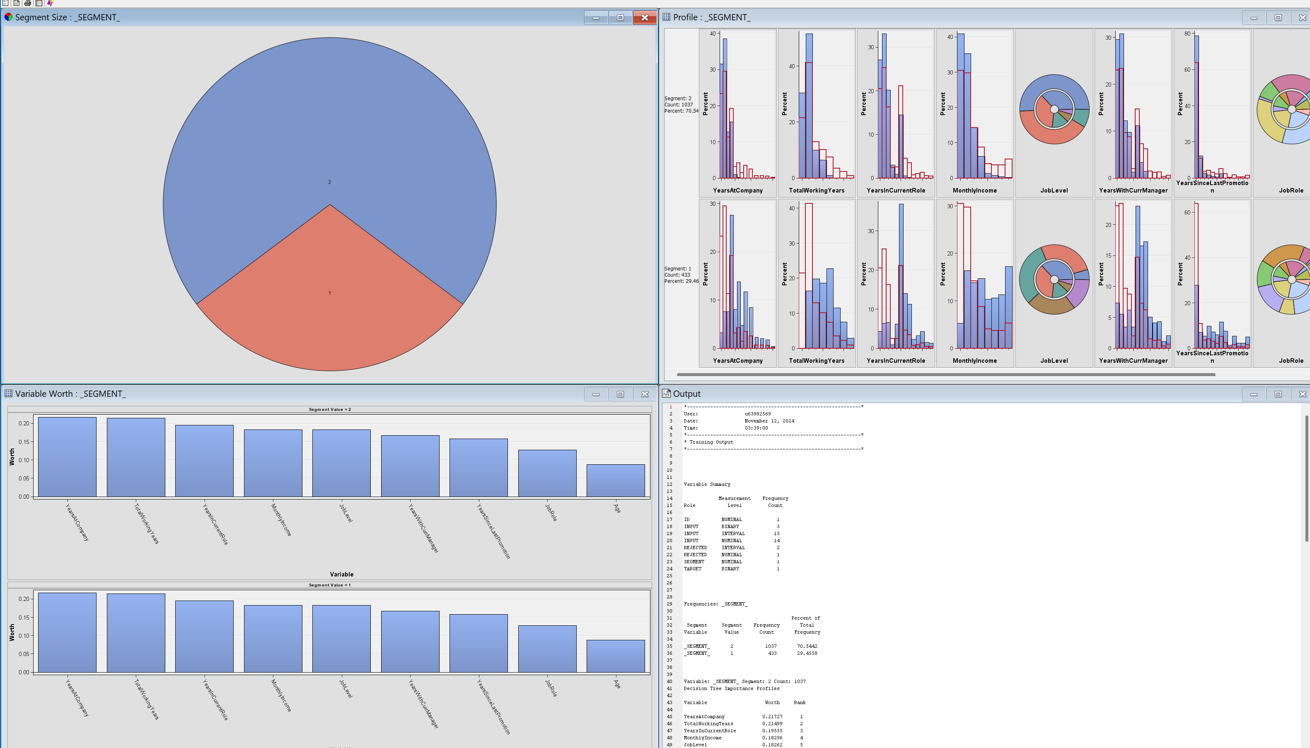
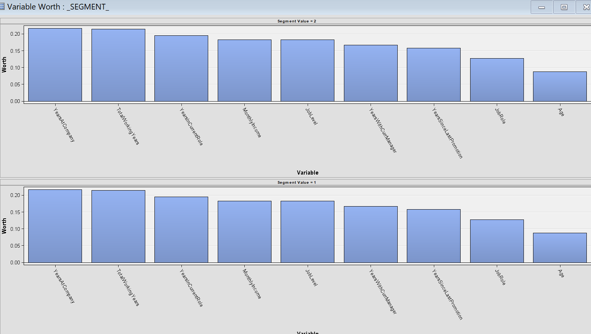
Model 4: Cluster Analysis
We conducted a clustering analysis to better understand the data and to identify underlying relationships or patterns among groups of variables.
This approach helps reveal how different features interact and can highlight meaningful segments within the dataset.

Slide 18
Findings
What did the model tell you?
The cluster analysis revealed two distinct employee segments. Segment 1, “Early Career High Potentials,” includes employees with fewer years at the company who may feel less established.
Key factors like job level, monthly income, and career growth suggest these individuals could be more prone to attrition if they perceive limited advancement opportunities or inadequate compensation.
Segment 2, “Steady Performers,” consists of more tenured and stable employees, generally associated with lower attrition rates. However, factors such as a lack of recent promotions or dissatisfaction with income could still motivate some to leave. These insights highlight diverse drivers of employee retention across segments.
Which variables are important?
The model identified several important variables, with Monthly Income emerging as the most critical factor influencing clustering.
Other highly important variables include Years at Company, Total Working Years, Job Role, and Job Level.
These variables suggest strong influence patterns that impact how data points are grouped.

Slide 19
Findings
How do they influence your dependent variable(s) of interest?
Monthly Income : is the most significant determinant, implying that clusters may be distinguished based on income levels. Higher or lower income brackets might form distinct groups.
Years at Company ,Total Working Years also play a crucial role, suggesting that tenure and experience are major factors influencing how individuals are clustered. This indicates that career duration can affect the cluster formation.
Job Role and Job Level influence clustering, indicating that occupation type and hierarchical level are important in distinguishing groups.
Age influences clustering, which could indicate generational differences or stages in career progression.
Is one more important than the others?
While Monthly Income is the most influential variable, Years at Company and Total Working Years are also highly significant, though slightly less impactful.
Variables like Job Role and Job Level remain crucial but are less important than income and experience metrics

Slide 20
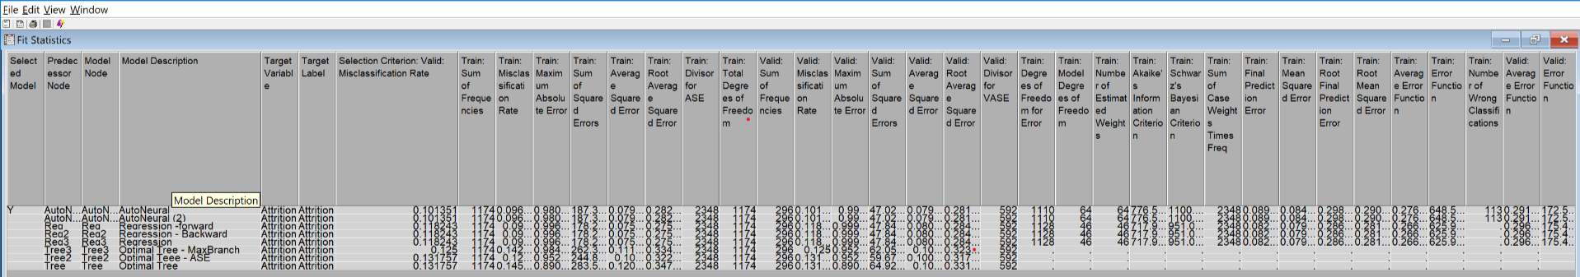
Model value Comparison from SAS Output
From the model comparison, here are the misclassification rates for each model based on the validation data:
The Auto Neural model has a misclassification rate of 0.101351
The Auto Neural - 3 hidden layers model has a misclassification rate of 0.101351
All three Regression models (Forward, Backward, and Regular) share the same misclassification rate of 0.118243
The Optimal Tree - Max Branch have misclassification rate of 0.125
The Optimal Tree models and ASE each have a misclassification rate of 0.131757
Based on the Misclassification Rate, the model with the lowest misclassification rate is generally considered the better one for classification purposes.
Best Model: The Auto Neural model with a misclassification rate of 0.101351 has the lowest rate among all models, making it the best choice based on this metric alone.

Slide 21
Managerial/business recommendations
Business Recommendation | Action | Goal
Address Overtime Concerns | Prioritize reducing excessive overtime by implementing workload management strategies and monitoring work hours closely. Encourage managers to regularly review employee schedules and redistribute tasks to prevent burnout. | Improve employee well-being and job satisfaction by ensuring a sustainable work-life balance, ultimately reducing attrition.
Optimize Compensation with Focus on Monthly Income | Review and adjust monthly income levels to ensure competitiveness, particularly for roles with higher turnover risk. Consider offering performance-based incentives or salary adjustments to retain top talent. | Decrease financial-driven attrition by providing fair and attractive compensation that aligns with employee expectations and industry standards.
Leverage Experience in Retention Plans | Recognize the importance of total working years by offering tailored development opportunities to experienced employees, such as mentorship roles or pathways to leadership positions | Retain seasoned employees by valuing their experience and offering meaningful growth opportunities within the organization.
Tailor Strategies Based on Job Roles | Develop job role-specific retention strategies. For example, provide clear career advancement paths for roles prone to high turnover and offer role-specific training or development programs. | Reduce attrition by addressing job-specific concerns and improving employee engagement through role-appropriate initiatives.
Enhance Stock Option Plans | Review and improve stock option offerings to provide meaningful long-term incentives for employees. Emphasize the financial benefits of staying with the company over time, especially for key roles. | Increase retention by aligning employees’ financial interests with the company’s success, fostering a sense of ownership and commitment.

Slide 22
Managerial/business recommendations
Business Recommendation | Action | Goal
Strengthen Work-Life Balance Initiatives | Implement flexible work arrangements, wellness programs, and mental health support tailored to employees most at risk of burnout. Promote a culture that respects personal time and well-being. | Create a supportive work environment that enhances overall satisfaction and reduces stress-related attrition.
Implement Targeted Retention Programs | Use the model’s predictions to identify at-risk employees early and initiate personalized retention efforts, such as career development opportunities or mentorship programs. | Reduce turnover by proactively addressing employee concerns and fostering long-term engagement..
Enhance Employee Engagement Efforts | Focus on boosting engagement for high-performing employees who may feel undervalued or dissatisfied. Offer recognition, development opportunities, or flexible work arrangements to address their needs. | Increase loyalty and job satisfaction by resolving issues that cause disengagement, particularly for high-risk roles.
Monitor and Address Departmental Trends | Use the model to identify departments or job roles with elevated attrition rates. Conduct detailed analyses to uncover specific challenges, such as compensation, workload, or management practices. | Implement targeted interventions to address pain points and improve retention in high-turnover area.
Utilize Predictive Analytics for Workforce Planning | Apply the model’s insights for strategic workforce planning, such as anticipating future turnover and developing a robust talent pipeline. Use data to inform succession planning and prepare for upcoming skill needs. | Build a forward-looking talent strategy that minimizes disruptions and ensures the company is well-prepared for future workforce demands.

Slide 23

Conclusion: Key Insights & Business Value
Predicting Employee Attrition
Identifies employees at risk of leaving, enabling proactive interventions.
Targeted Retention Strategies
Implement personalized incentives, career development programs, and work-life balance improvements.
Reducing Turnover Costs
Lower recruitment and training expenses by retaining top talent.
Optimizing Workforce Stability
Minimize the need for continuous hiring, creating a more stable and motivated workforce.
Boosting Organizational Success
Increased employee loyalty directly impacts productivity, performance, and profitability.
Conclusion:
Data mining has revealed key factors behind employee attrition at IBM. Our models help HR teams identify employees at risk of leaving. This allows for proactive retention strategies targeting these employees. Data-driven approaches can reduce attrition rates. Benefits include greater workforce stability, Higher employee satisfaction, Improved productivity and Enhanced overall business performance.

Slide 24

References
Data set @Kaggle Link
https://www.kaggle.com/datasets/pavansubhasht/ibm-hr-analytics-attrition-dataset
IBM Employee statistics Website
https://www.statista.com/statistics/265007/number-of-employees-at-ibm-since-2000/

Slide 25


Slide 26
Backup slide

Slide 27
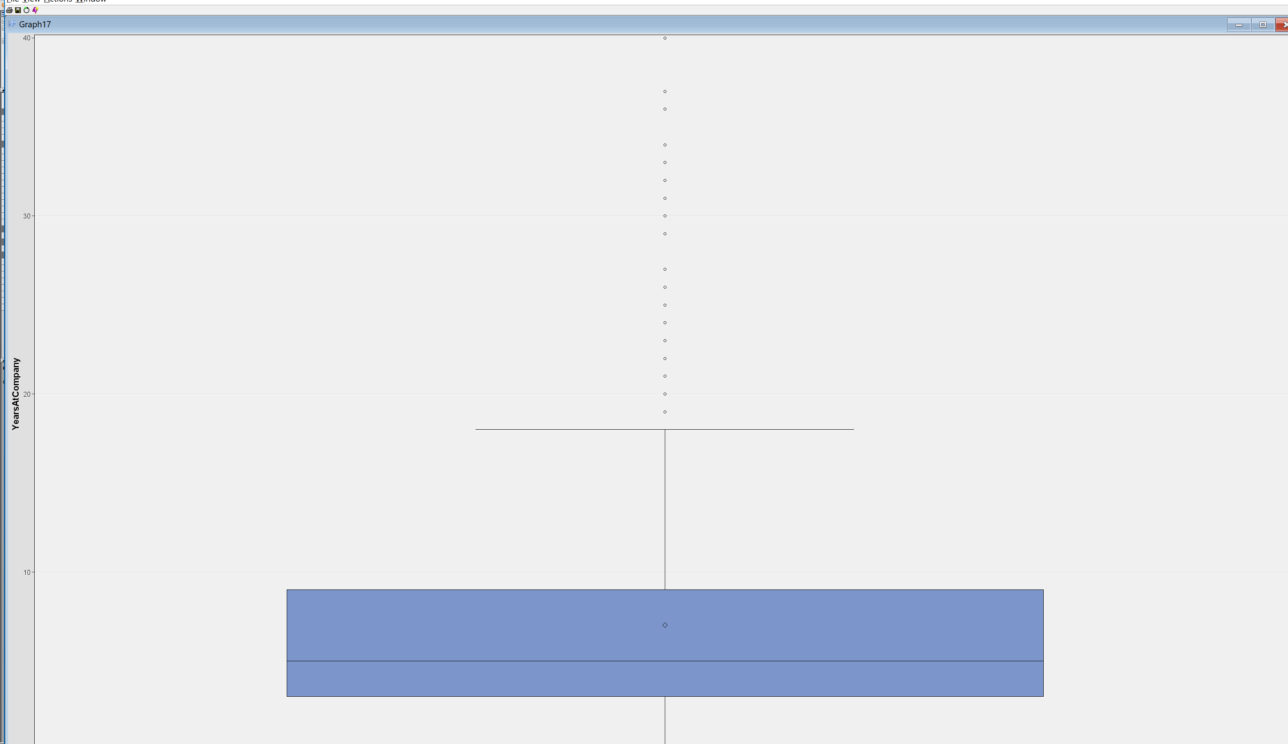
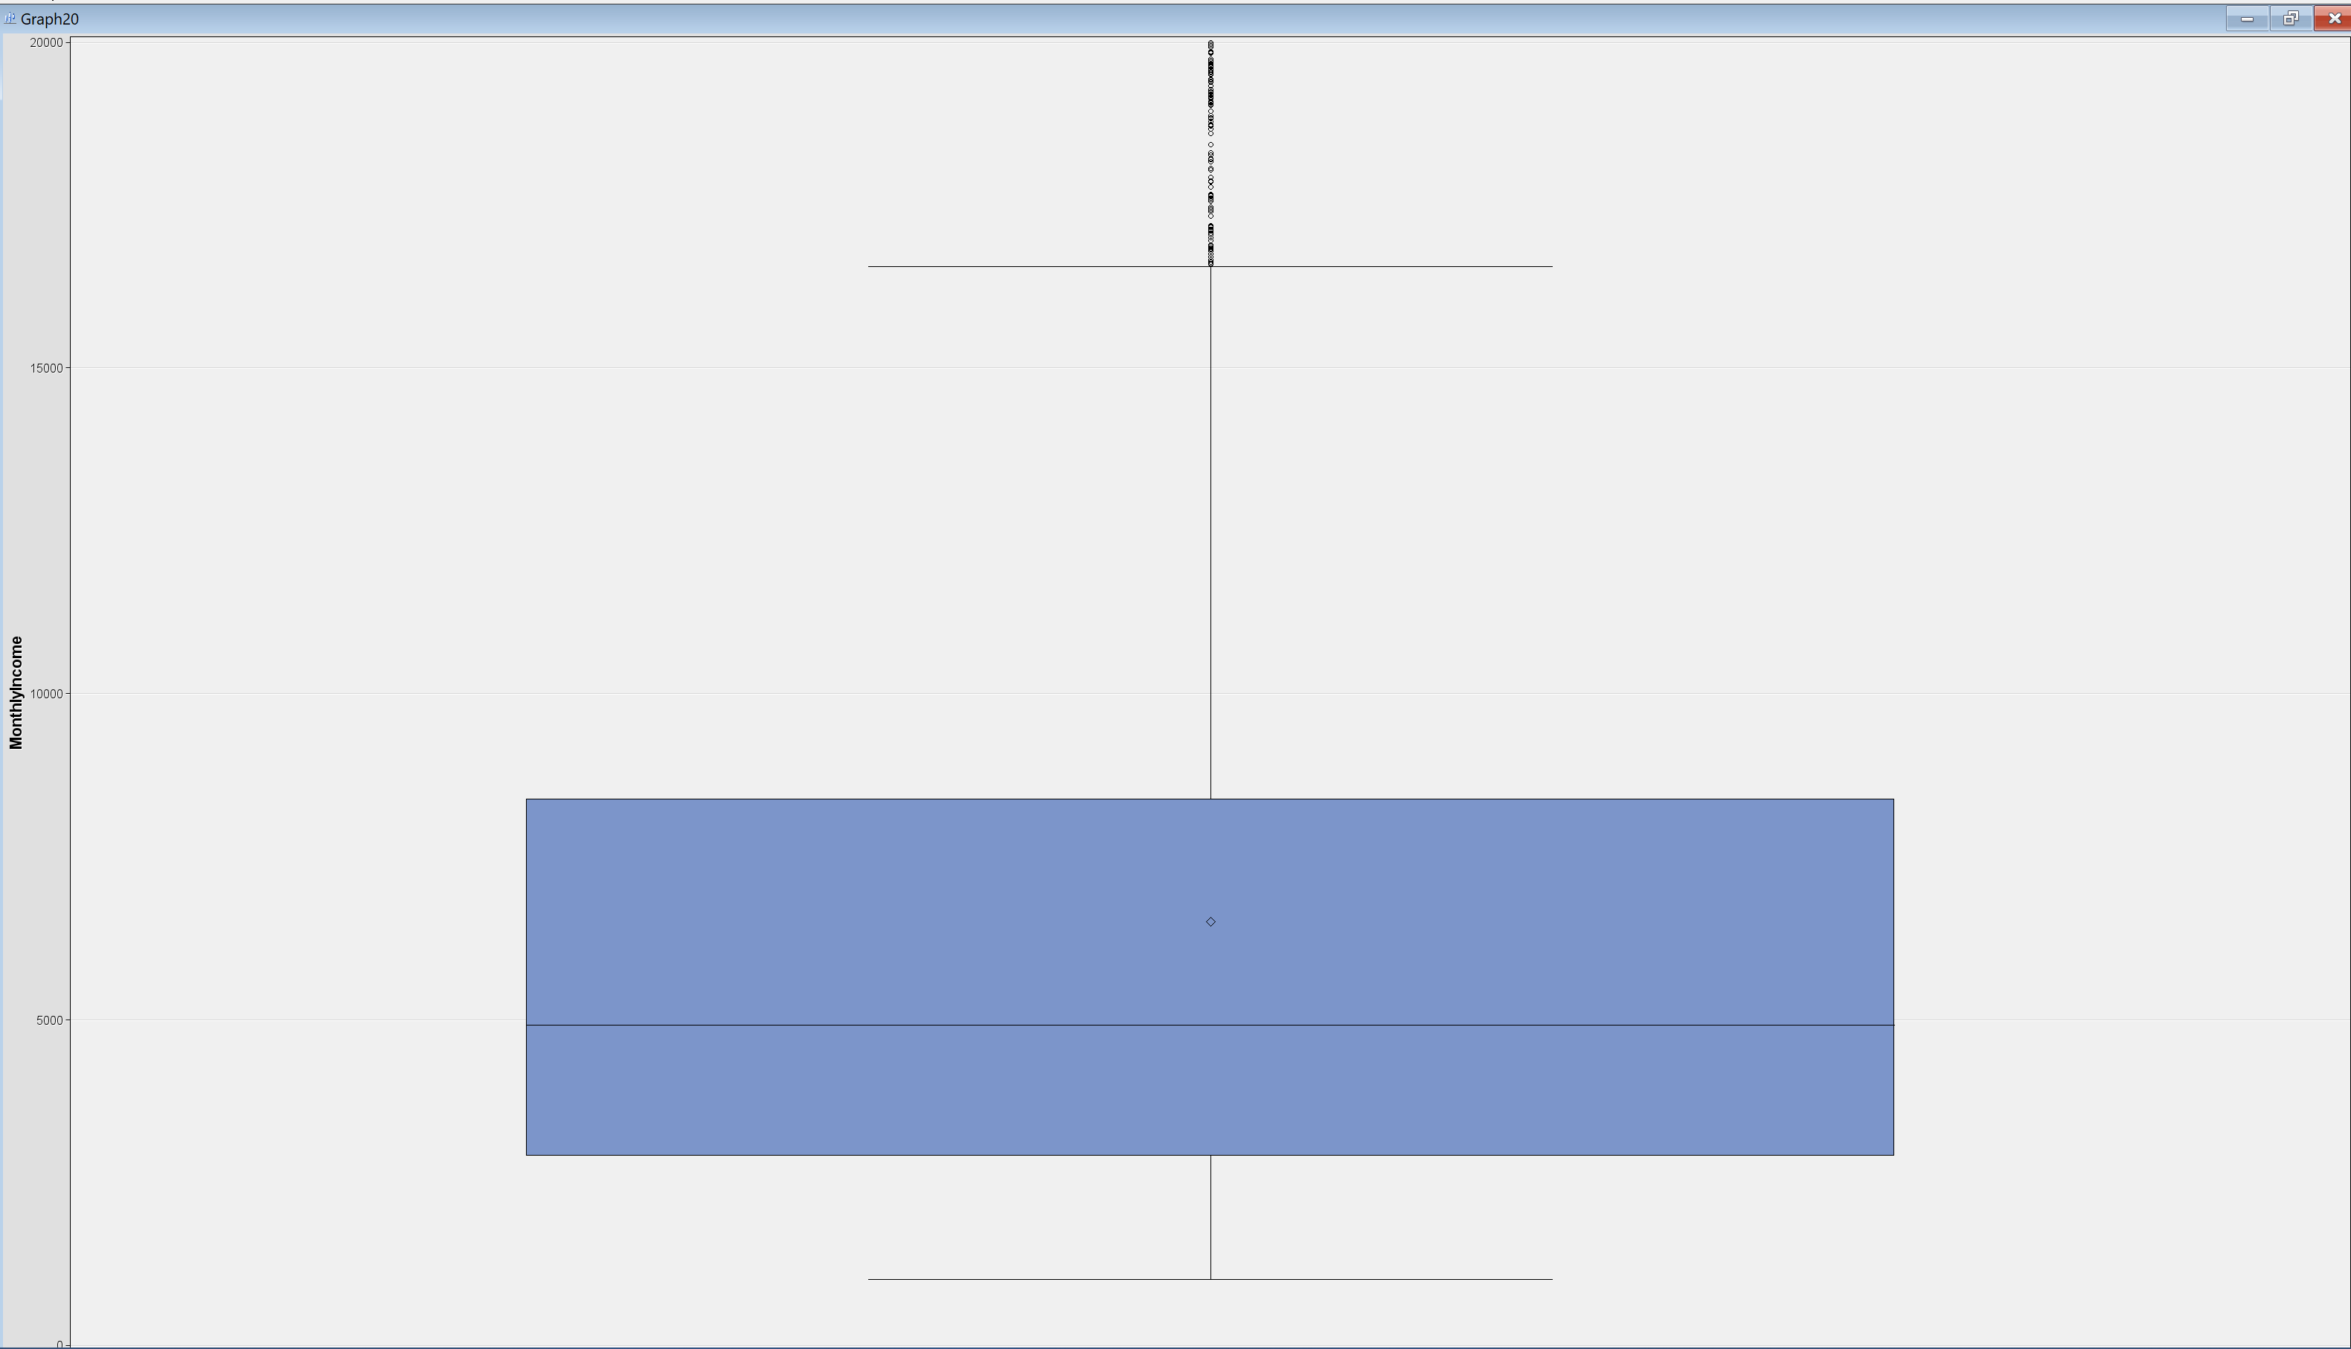
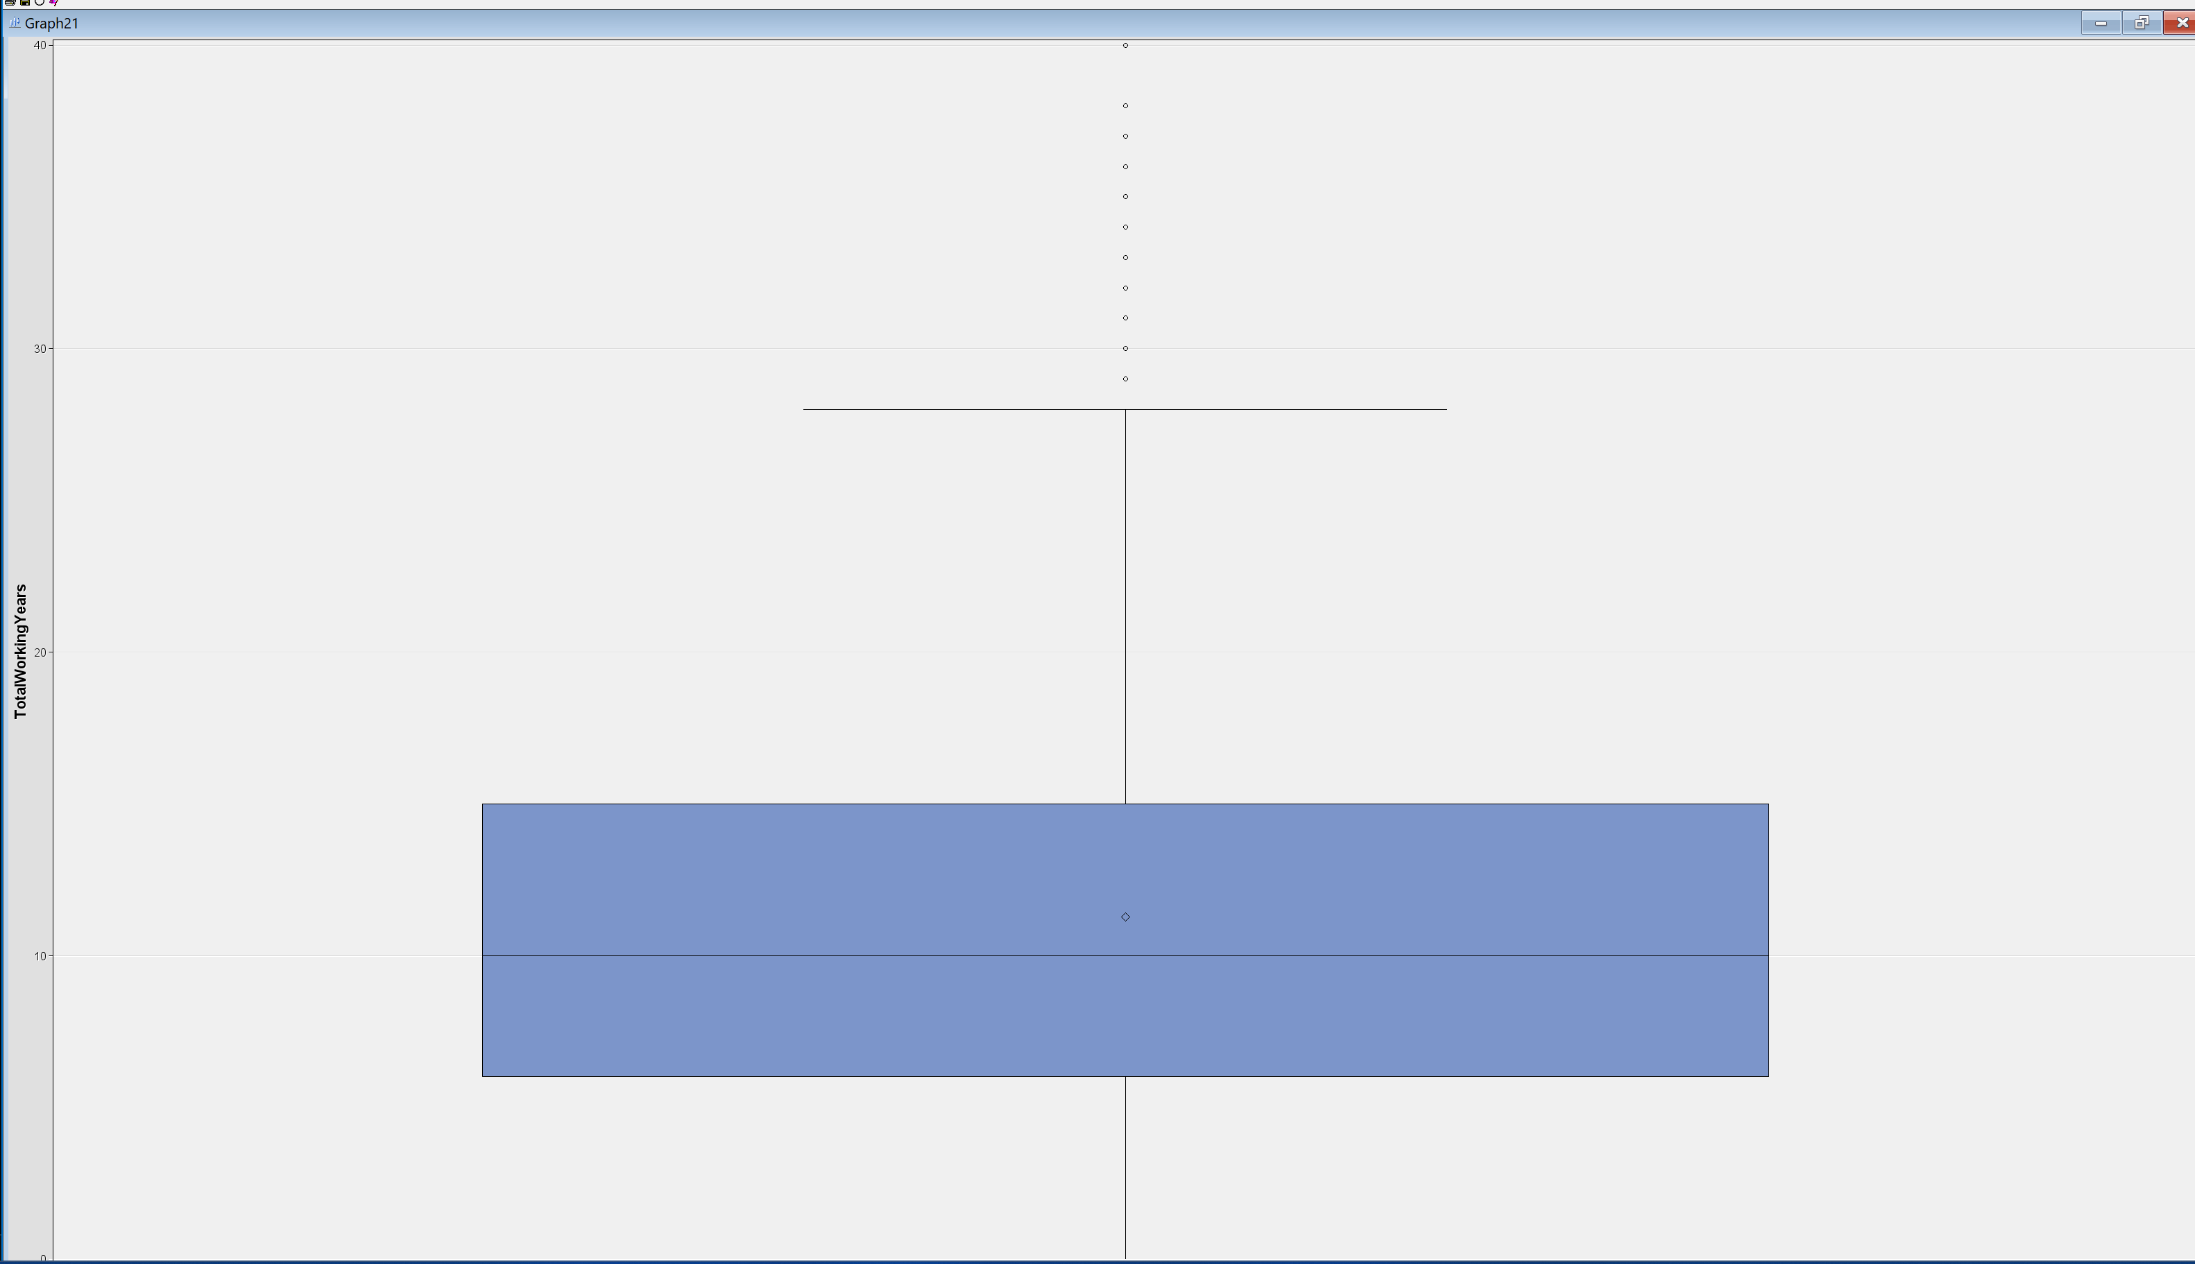
Outliers Images

